Slide 1
Basic Concepts of Epidemiology & Social Determinants of Health
Prof. Supannee Promthet
27 Septmber 2013: 9.00-12.00

Slide 2
Goals of this lecture are:
1.) Students will have a general understanding of what the field of Epidemiology is and its importance to Public Health.
2.) Students will have a general understanding of social determinant of health
3.)Students can discuss how social determinants of health affect/contribute to the development of various illnesses

Slide 3
Acknowledgement
http://www.authorstream.com/Presentation/bharatmewara-1707081-epidemiology/
http://www.authorstream.com/Presentation/drarvindkushwaha-1352023-infectious-disease-epidemiology/
http://www.authorstream.com/Presentation/ashokk_kapu-85122-general-epidemiology-ashok-epid-new-entertainment-ppt-powerpoint/

Slide 4
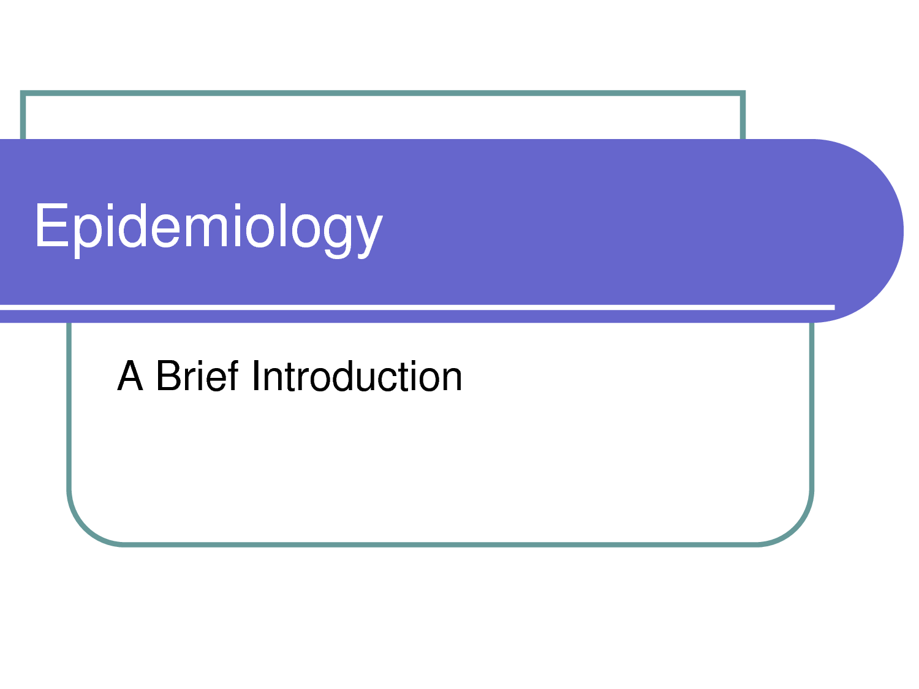

Slide 5
Meaning of epidemiology:-
Epi= Among
Demos= People
Epidemiology
Logos= Study/ Science

Slide 6


Slide 7
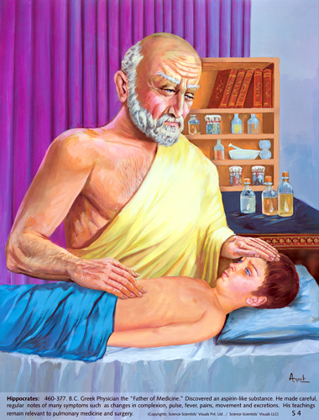
Hippocrates
The father of medicine.
First epidemiologist.
First person to have examined the relationships between the occurrence of disease and environmental influences.
He coined the terms endemic (for diseases usually found in some places but not in others) and epidemic (for diseases that are seen at some times but not others)

Slide 8
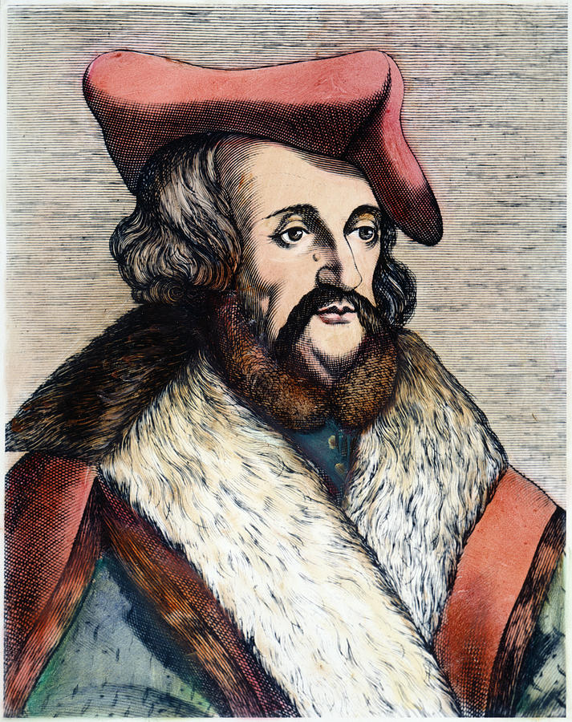
Girolamo Fracastoro
Fracastoro's theory
It stated that each disease is caused by a different type of rapidly multiplying minute body, transmitted by direct contact, by carriers such as soiled clothing or through the air.
Focused on promotion of personal and environmental hygiene to prevent disease.

Slide 9
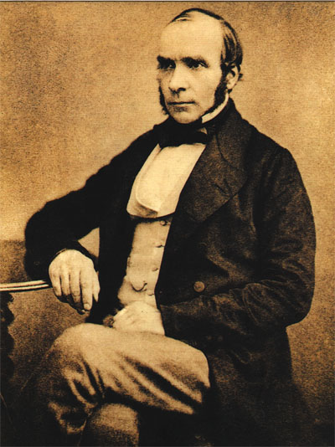
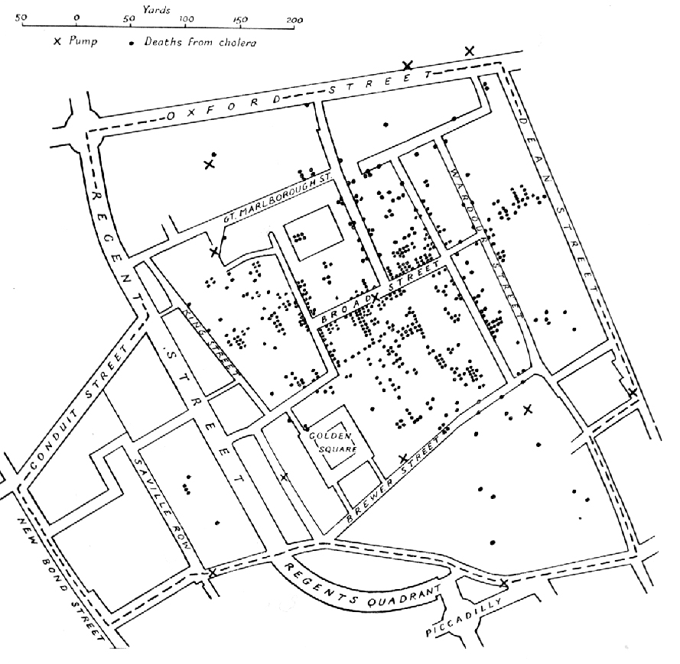
Dr. John Snow
Known as the father of (modern) epidemiology.
Investigated the causes of the cholera in London in19th century .

Slide 10

Definition of Epidemiology:-
“Epidemiology is the study of frequency, distribution and determinants of health-related states or events in specified population and the application of the study to control health problems.”
John M. Last (1988)

Slide 11
Components of epidemiology:
Study of the frequency of disease
Study of the distribution of disease
Study of the determinants of diseases.

Slide 12
Study of the frequency of disease: -
Measurement of frequency of disease, disability or death in the form of rates, ratios and proportions.
Prevalence rate,
Incidence rate of disease,
Death rate
health needs & health demands
health care utilization
Male-female ratio
etc

Slide 13
Epidemiological approach
Asking Questions
Making Comparisons

Slide 14
Asking questions
Related to Health Events:
What is the event (problem)?
What is the magnitude ?
Where did it happen ?
When did it happen ?
Who were affected ?
Why did it happen

Slide 15
Related to Health Action
What can be done to reduce this problem and its consequences?
How can it be prevented?
What action should be taken by the community? By other sectors? Where and for whom these activities be carried out?
What resources are required? How are the activities to be organised?
What difficulties may arise, and how might they be overcome?

Slide 16
Making comparisons
Between two ( or more groups)
One group having the disease and the other group not having the disease
Comparison between individuals

Slide 17
Basic measurements in epidemiology
Measurement of mortality
Measurement of morbidity
Measurement of disablity
Measurement of natality
Measurement of presence or absence or distribution of characters or attributes of the disease

Slide 18
Measurement of medical needs, health care facilities, utilisation of services and other health related events
Measurement of presence or absence or distribution of the environmental and other factors suspected of causing the disease
Measurement of demographic variables.

Slide 19
Tools of measurements
Rates
Ratios
Proportions

Slide 20
Rate
500 deaths from motor vehicle accidents in city A during 1985
For comparison between City A and City B calculate Rate
Rate measures the occurrence of some particular event in a population during a given time period.

Slide 21
Death Rate:
Specific Rate: Disease specific, age-group specific, specific time periods
Standardized rates: By direct method and indirect method

Slide 22
Ratio
Expresses a relation in the size between two random quantities.
Numerator is not a component of denominator
X : Y = X/Y

Slide 23
Proportion
A proportion is a ratio which indicates the relation in magnitude of a part of the whole.
Numerator is always included in the denominator.
Usually expressed as percentage.

Slide 24
Adjusted or standardized rates
Direct Standardization
Indirect standardization

Slide 25
Direct Standardization
Select a standard population
A standard population is defined as one for which the numbers in each age and sex group are known.
Apply to the standard population, the age-specific rates of the population whose crude death rate is to be adjusted or standardized.

Slide 26
Age | MYP per 1000 | Deaths in the year | Age specific death rates
0 0 – 4 5 – 14 15 -19 20 – 24 25 – 34 35 – 44 45 – 54 55 - 64 | 4000 4500 4000 5000 4000 8000 9000 8000 7000 | 60 20 12 15 16 25 48 100 150 | 15.0 4.4 3.0 3.0 4 3.1 5.3 12.5 21.4
 | 53,500 | 446
Crude death rate per 1000 = 8.3

Slide 27
Age | Standard population | Age specific death rates per 1000 | Expected deaths
0 0 – 4 5 – 14 15 -19 20 – 24 25 – 34 35 – 44 45 – 54 55 - 64 | 2400 9600 19000 9000 8000 14000 12000 11000 80000 | 15.0 4.4 3.0 3.0 4 3.1 5.3 12.5 21.4 | 36 42.24 57 27 32 43.4 6306 137.5 171.2
 | 93000 |  | 609.94
Standardized death rate = 6.56

Slide 28
Measurement Morbidity
“ any departure, subjective or objective, from a state of physiological well-being”
Sickness, illness, disability
Frequency
Duration
Severity

Slide 29
Incidence
“ the number of new cases occuring in a defined population during a specified period of time”
Number of new cases of specific disease
during a given time period
= --------------------------------------------- X 1000 Population at risk during that period

Slide 30
Uses of incidence rate
Useful for taking action
A) to control disease
B) for research into etiology and pathogenesis, distribution of diseases, efficacy of preventive & therapeutic measures

Slide 31
Prevalence
All current cases (old & new) existing at a given point of time, or over a period of time in a given population
Definition: the total number of all individuals who have an attribute or disease at a particular time divided by the population at risk of having the attribute or disease at this point in time or midway through the period

Slide 32
Point prevalence: the number of all current (old and new) cases of a disease at one point in time in relation to a defined population.
Number of all current (old &new) cases of
specific disease existing at a given time period
= ----------------------------------------------------- X 100 Estimated Population at the same point of time

Slide 33
Period prevalence
Period prevalence: the number of all current (old and new) cases existing during a defined period of time expressed in relation to a defined population.
Number of existing cases (old &new) cases of a
specified disease during a given period of time interval
= ----------------------------------------------------- X 100 Estimated mid-interval Population at risk

Slide 34
Epidemiologic triad
Demographic characteristics
Biological characteristics
Socioeconomic characteristics
Host
Agent
Environment
Biological agents
Physical agents
Chemical agents
Nutrient agents
Mechanical agents
Social agents
Physical environment
Biological environment
Social environment

Slide 35
Infectious Disease Model
Pathogen
Host
Disease
Environment

Slide 36
Epidemiology Method
Second file

Slide 37
Questions???

Slide 38
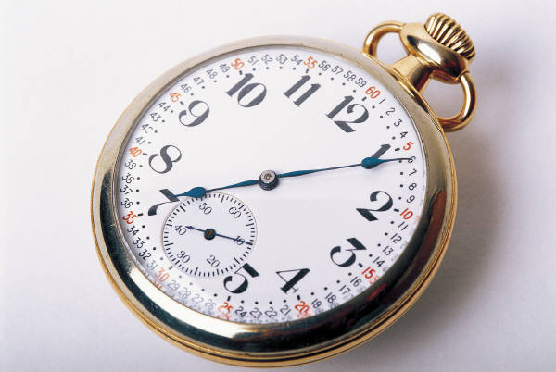
10 Minute Break

